Slide 1

ETL Project – Sugar Analysis
By: Caitlan Beachey, Amaris Hassan, Cecilia Leung, Hillary Mandich, Kapil Pundhir

Slide 2
Agenda
What does ETL stand for?
Extract Data
Transform Data
Load Data to Cloud Server
Summary

Slide 3
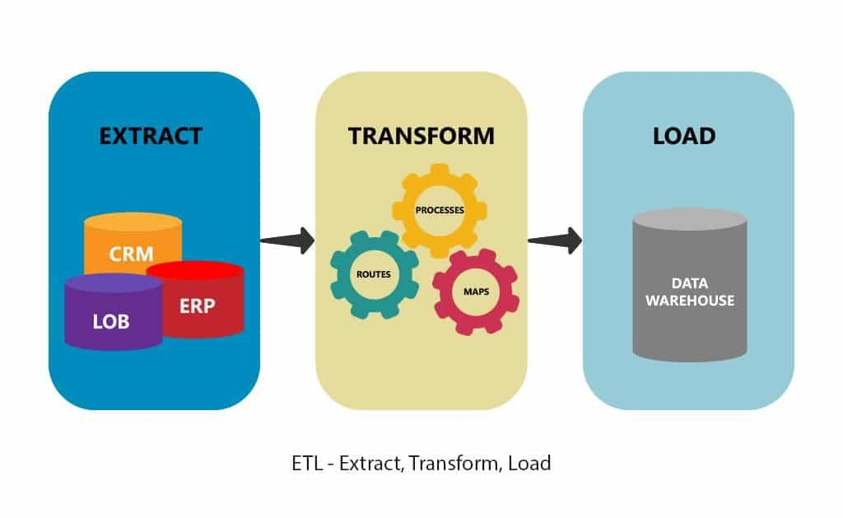
What does ETL stand for?

Slide 4
Extraction
Step 1: Continue to add datasets from last topic of Sugar Analysis.
Step 2: Define which datasets to use.
Step 3: Research more on additional datasets that can be used for SQL.
Step 4: Finalize which datasets to use.
Step 5: Drew an ERD to determine how the datasets are related to one another.

Slide 5
ERD Diagram

Slide 6
Data Sources

Slide 7
Transform

Slide 8
Load

Slide 9
Summary

